Slide 1

ICEG
REVIEW COMITE
23/05/2024

Slide 2
Welcome & agenda of the meeting

Slide 3
AGENDA
TOPIC | SPEAKER | TIMING
Welcome and agenda | Raf Buyle & Marc Bruyland | 14u00 – 14u05
ICEG IMKL – status, approach and next steps | Ivy Van De Kerchove | 14u05 – 14u15
ICEG Person – start trajectory | Mathieu Tulpinck / Liesbet D'Hondt | 14u15 – 14u25
ICEG Hydrants – status update | Jitse De Cock | 14u25 – 14u35
Status ICEG agreement 2024-2025 | Marc Bruyland | 14u35 – 14u45
Other?

Slide 4
IMKL – model towards ICEG Governance (Ivy Van De Kerchove - 10')

Slide 5











IMKL project
5 tracks – symbol indicates current status
Update semantic datamodel
Legal recognition IMKL
Cooperation agreement
Development implementation model
Developments in KLIP for implementation of new data model

Slide 6
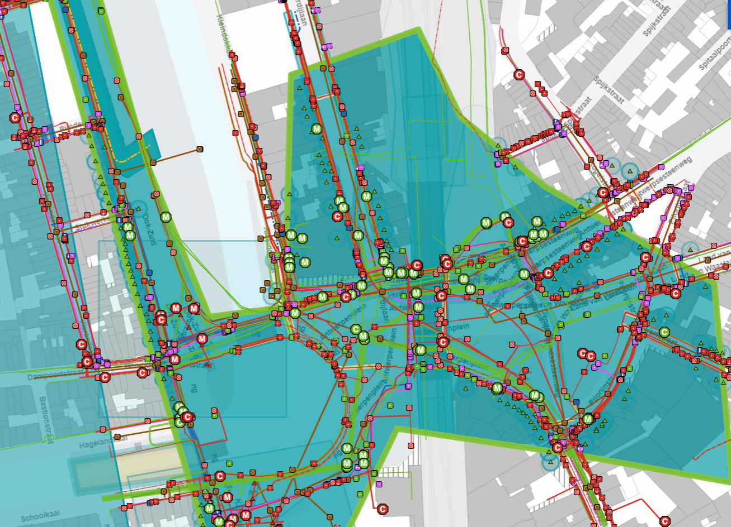
IMKL
IMKL within ICEG:
Recognition as national datastandard
Governance for cooperation agreement
First introduction on ICEG review committee: march 2023
Today: finalization towards official recognition and statusupdate cooperation agreement

Slide 7


IMKL as a national datastandard
Trajectory on update datamodel
Update semantic datamodel via OSLO trajectory
Agreement on working towards ICEG recognition: March 2023
OSLO working groups on semantic model: between April & November 2023
Organized & financed by Flanders
Stakeholders from all Belgian regions included
Agreement on shortened ICEG procedure: March 2024
Validation webinar: May 14th 2024

Slide 8



IMKL ICEG recognition
ICEG Validation Webinar 14/05/2024
Representatives of stakeholdergroups (cfr. next slides)
All parties were in favor of having IMKL recognized as
a national standard
Can we have a formal statement in the ICEG Management Committee of June 26th?

Slide 9
Present in validation webinar 14/05/24
Name | Organisatie | Regio
BEECKMANS Hilde (NEO/NNT) | VRN / Proximus | Vlaanderen / Nationaal
jean paul Wouters | CGRB | Brussels Hoofdstedelijk Gewest
Soumoy Gontran | KLIM / Fluxys | Nationaal
danny.vanderhaeghen@elia.be | KLIM / Elia | Nationaal
CAPPELLE Ruben | SPRB Brussels | Brussels Hoofdstedelijk Gewest
Vandesompele Marlies | KLIM / Elia | Nationaal
Rink W. Kruk | NGI | Nationaal
BUFFET Dominique | SPW Digital | Wallonië
BOOGAERTS Philippe | GOB Brussels | Brussels Hoofdstedelijk Gewest

Slide 10
Consulted by e-mail / meeting report 14/05/2024
Name | Organisatie | Regio
STROBBE Dimitri | Bruxelles Mobilité | Brussels Hoofdstedelijk Gewest
Marc.bruyland | ICEG / FOD Bosa | Federaal
HANNECART Claude | Paradigm | Brussels Hoofdstedelijk Gewest
Pascale.Blondiau@AGRW.be | AGRW | Wallonië
vincent.decruyenaere@bouwunie.be | Bouwunie | Vlaanderen
Huybrechts Gert | Embuild | Vlaanderen
VAN WOENSEL Tine | GOB Brussels | Brussels Hoofdstedelijk Gewest
liesbet.dhondt | FOD Bosa | Federaal
Bart Hanssens (BOSA) | FOD Bosa | Federaal
De Paepe-Harmsen Ingrid | KLIM / Fluxys | Nationaal
ZAOUDACHVILI DIMITRI | Vivaqua | Brussels Hoofdstedelijk Gewest
LAGNEAU OLIVIER | Vivaqua | Brussels Hoofdstedelijk Gewest
Vincent Mignolet | SPW Mobilité & Infrastructure | Wallonië
Julie Van Langendijck | SPW Mobilité & Infrastructure | Wallonië
Jean-Claude Jasselette | SPW Digital | Wallonië

Slide 11


IMKL cooperation agreement
Point of view: we are “x” years ahead in time and IMKL 3.0 is in use
We work together with all Belgian regions on maintenance
From the national IMKL 3.0 model
For this we need an agreement that states:
How we will organize ourselves
How changes to the model will be financed
And all this within a legal framework

Slide 12
Pioneer
National support by ICEG data standard recognition as a base for the contract
Broader involvement (e.g. Athumi)
Contract with indefinite duration
Maintenance contract (instead of new standard)
Different governance
Obligatory nature of IMKL
Notes:
Pionier want: ​
Het is al gedragen door de verschillende gewesten (deelname aan semantisch traject)​
Niet alle betrokken partijen zitten al in de ICEG werking (Athumi)​
onbepaalde duur​
onderhoud van een bestaande standaard t,a,v, ontwikkeling nieuwe standaard​
andere beheersstructuur met werkgroep/stuurgroep​
Het verplichtende karakter maakt geen deel uit van de ICEG standaardisatieovereenkomst zoals we die kennen

Slide 13
Cooperation concerned parties
Flemish Region
Athumi
Brussels Capital Region
Paradigm
Federal Govern-ment
Department within FOD: TBC
Walloon Region
Department within SPW: TBC
Bruxelles Mobilité
Notes:
SPW: TBD Mobilité & Infrastructure of Digital – of beide
Waarschijnlijk FOD Economie, nog afhankelijk van financieel delegeringsbesluit
Paradigm & BM klaren zijn verschillende juridische entiteiten & klaren nog uit hoe ze zich tegenover elkaar gaan verhouden (Paradigm vertegenwoordigt eigenlijk niet persé de regio)

Slide 14
Cooperation agreement status update
First draft document initiated in Flanders: Q3 2023
First consultation meeting with all regions: Q1 2024
Today: working on final version with ambition to have the cooperation agreement signed by end of Q2 2024.
To do:
Some minor improvements on textual formulations
Which representative signs for FOD / SPW?
BXL: positioning of BXL Mobilité versus Paradigm
When position of BXL clarified: finalization repartion key

Slide 15
IMKL ICEG recognition
ICEG Validation Webinar 14/05/2024
Representatives of stakeholdergroups (cfr. next slides)
All parties were in favor of having IMKL recognized as
a national standard
Can we have a formal statement in the ICEG Management Committee of June 26th?

Slide 16
ICEG Person – Start trajectory (Mathieu Tulpinck/Liesbet D'Hondt- 10')

Slide 17
ICEG Person
Request to open a thematic traject on person. Draft charter.
Draft publication (for discussion purposes only).
Use cases include evolution of data over time.
Reframing of data in legal terms.

Slide 18
ICEG Person – Next steps: Onepager
Onepager to outline and contextualize this initiative towards interoperability.
More information about our efforts and why a shared and formalized data model is needed.
Engaging partners for the implementation of this data model and commitment to participate in the workshops.
Draft
Revision
Validation
ICEG Review Comité
Partners of KSZ/CBSS and Rijksregister/Registre National
ICEG Management

Slide 19
Hydrants – Status Update (Jitse De Cock- 10')

Slide 20
ICEG Hydrants - Status update
What has been done in 2023?
Business workshop (07/02/2023)
2 webinars (18/04/2023 and 22/06/2023)
1 physical workshop with AquaWal, AquaFlanders and other FR-speaking actors in Namur (29/08/2023)
Extend the public review period and prepare a simple spreadsheet for stakeholders to review and share feedback
Processing of feedback received via GitHub issues and email and the accompanying stakeholder management
Preparation of the 3rd webinar (6/12/2023), integrating the feedback shared until 30/11 and which was cancelled the day before following a meeting with the federations of water companies in which Rink participated
Preparation and iterations on the model to prepare its publication (the model and its artefacts are currently available in draft on GitHub)
Simplification of the GitHub user interface
Notes:
Optional fields -> rationale

Slide 21
ICEG Hydrants - Status update
What has been done in 2024?
Preparation of a data example using the model and its underlying use cases
Updated preparation of the 3rd webinar planned on 22/02 (postponed).
Bilateral discussions with AquaWal and UVCW (Union des Villes et Communes Wallonnes).
Physical workshop on 28/03/2024.
Drafted & published the meeting report,
Published a new version of the data model
Created and shared a supportive spreadsheet to collect additional feedback from the stakeholders on the revised model.
Extensive stakeholder management efforts.
Notes:
Optional fields -> rationale

Slide 22
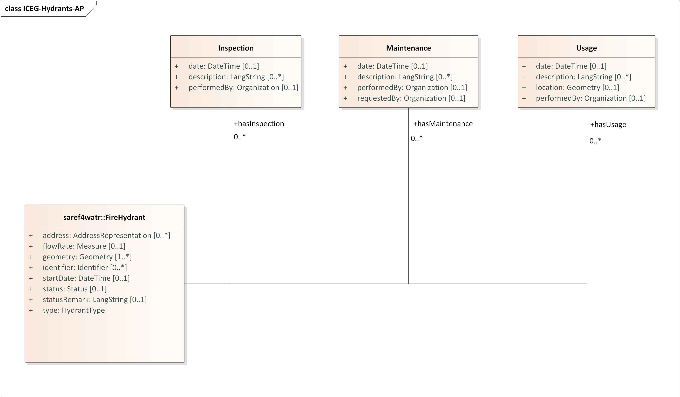
ICEG Hydrants - Status update
Updates to the model
Addition of classes based on information requirements of the water companies
Minor changes to cardinalities, definitions and usage notes
Full changelog via this link
Notes:
Optional fields -> rationale

Slide 23
ICEG Hydrants - Status update
What still needs to be done?
Facilitate additional discussions regarding the data model:
Cardinality
Additional attributes
Data types
…
Creation of additional data examples, following use cases requested by the stakeholders.
Preparation of a potential additional workshop & closing webinar.
Separate meeting with Aquawal and the other water companies in Namur.
Stakeholder management of Flemish, Walloon and Brussels parties.
Request: additional budget (20MD) would be required in order to finalise the specification and achieve consensus between all parties
Notes:
Optional fields -> rationale

Slide 24
Status ICEG Agreement 2024-2025 (Marc Bruyland - 10')

Slide 25

Thank you for your attention
Any questions?
Notes:
Verschillende opties als tussenslide

